Slide 1
Booting CD/DVD…
Starting Windos 3 setup…
Click me to start up

Slide 2
setup
Welcome to setup!
This setup installs Windos 3 on your computer.
Please press next to continue.
Next>

Slide 3
setup
Please enter your username and press next:
Username Password
next

Slide 4
setup
Please enter the 25-digit product key below:
RBDC9-VTRC8-D7972-J97JY-PRVMG
next

Slide 5
setup
Thanks for not stealing this installation.
Please press next to begin the identifying process.
Next>

Slide 6
identifier
Welcome, user!
Whet is your full name?
>
Username password

Slide 7
identifier
How old are you?
Type in a NUMBER ONLY!
>
346587456~@}XRCFGVH

Slide 8
error
X

Slide 9
identifier
Please enter the correct age:
>
35

Slide 10
identifier
Thanks for completing this short form.
We will now connect you to the Internet.
OK

Slide 11
Internet Wizard
Searching for Internet devices…
>

Slide 12
Internet Wizard
Would you like to connect to the Internet now?
✓

Slide 13
Internet Wizard
Connecting to the Internet…

Slide 14
Internet Wizard
Connected to the internet.
Testing the connection…

Slide 15
info
X
You have connected to the Intranet!
This is the opposite of the Internet sadly but it is 100x better!

Slide 16
Internet Wizard
Press the below button to exit:
X

Slide 17
installer
Press the below button to install Windos:
Install Windos

Slide 18
installer
Installing Windos 3…
Please wait…

Slide 19
success
X
Install complete!
Exit to start Windos 3!

Slide 20
setup
Was not completed successfully.
Close to crash PC

Slide 21
Booting from hard disk…
Starting Windos 3 …
Click me to start up

Slide 23
Windos 3:
This device is locked.

Slide 25

\\

Slide 27

\\websites\

Slide 28

received message
Fr:
Sj:

Slide 29
sent message
To:
Sj:

Slide 30
login
Username Password
Password:
>
********

Slide 31





X
Power menu:
Uninstall
Reinstall
Sign out
lock
What’s new in v1.00:
Windos 3 is now no longer in beta!
Moved OSOD widget to taskbar
Added 5 new emails
Added 3 new websites
Removed the mouse pointer
Updated news
Windos 3 updates will be a lot less often from now on
All apps
PC
Shortcuts:
PC
All apps
The Intranet
Email
Antivirus++
10 emails

Slide 32
Confirm uninstall
Are you sure?
✓
X

Slide 33




All apps
IE 15
email
Minecraft!
Antivirus++
7z 19.00
Scratch 2
Media player 1.00
OSOD

Slide 34
Uninstaller 1.00
Uninstalling Windos 3…
Please press the green bar to finish the process!

Slide 35
Booting from hard disk…
No bootable media found!
Booting from CD/DVD…
No bootable media found!
Booting from floppy…
No bootable media found!
Press ESC to power off the PC then insert some installation media.
ERROR NO MEDIA CODE 128

Slide 36
IE 15 CONNECTED
Welcome to the Intranet!
This is an offline Internet embedded into your Windos install.
Click on a hyperlink below to open a website that has been downloaded:
Ask Jeeves
Google
Alexa!™
Windos official website
Wikipedia++
Windos News
Feedback
Media downloader
MIME 1.02
Batman official website

Slide 37
Email: windos3@zigzag.net
Inbox
Sent items
close
Fr: hello@Microsoft.com
Fr: dev@windos3.org
Fr: dev@windos3.org
Fr: bill.gates@Microsoft.com
Fr: szymonmochort11@gmail.com

Slide 38
Email: windos3@zigzag.net
Inbox
Sent items
close
to: hello@Microsoft.com
To: ajsnv@ufdbu.com
To: windos3@zigzag.net
To: bill.gates@Microsoft.com
To: szymonmochort11@gmail.com

Slide 39

\\websites\ask-jeeves

Slide 40

\\websites\google
Loaded in compatibility mode
Some functions may not work
Please do not attempt to use this page as scripts have been disabled.
It is only an image and the scripts are off for security reasons.
BTW we disabled 128 scripts.

Slide 41









\\websites\alexa
Unleash the power of Alexa!
Alexa is your amazing virtual assistant that can do literally anything!
Just say “Alexa” to wake her up!
All it takes to get her is to buy an echo device from Amazon!
The device contains tens of thousands of skills including ones from:
And many more…
Alexa is developed by Amazon and is not a sponsor of Windos. Please note this.

Slide 42
received message
Fr: hello@microsoft.com
Sj: secrets of MS
Hello there Windos 3 user,
There is a thing I need to tell you.
MS are killing computers worldwide
Do not update Windows
Stick to Windos
Please do not use unsupported OSes and use Windows 10
Do not use IE
Use chrome
Set diagnostic data to basic
Pls follow my advice!
Signed,
A Microsoft employee
PS do not reply to this email!

Slide 43






C:\
D:\
docs
pics
vids
downloads

Slide 44


C:\
Windos
Shell32.dll

Slide 45
C:\Windos
system32
data

Slide 46
Access denied
You do not have sufficient privileges to open this file/folder
Contact your admin for more info

Slide 47
Under construction
Sorry but this feature is currently under construction
Please see if it is added in a future update!

Slide 48
sent message
To: hello@microsoft.com
Sj: RE secrets of MS
Hello hello@Microsoft.com
This is an automated message to say that all conversations are made by the computer only
The user cannot send mail.
Thank you,
The Windos 3 developer,
Szymon Mochort
PS do not reply to this email unless you want to be blocked.

Slide 49
received message
Fr: dev@windos3.org
Sj: welcome to Windos 3!
Welcome to Windos 3,a parody of Windows!
It is based on several windows versions and we just murdered old start menu!
Please note that this is an idea of mine and I mean no hate from it.
Please be considerate of this when using my OS
It is just a PowerPoint presentation so it has limited functionality.
Thanks for using Windos
Szymon Mochort.
PS you may mod and distribute it as long as you do not make $$$ from Windos or any mods of it.

Slide 50
Antivirus++
You have 304578694567 viruses!
Del all
Ignore all
Quarantine all
Update antivirus++

Slide 51
Del all
Cannot delete viruses
Run this app as an admin to do this!
<

Slide 52
quarantine all
Cannot quarantine viruses
Windos will not let antivirus++ ignore them.
<

Slide 53
Ignore all
antivirus++ has insufficient permission from Windos to actually ignore viruses!
<

Slide 54
Updater 1.01
Antivirus++ is up to date
<

Slide 55
sent message
To: ajsnv@ufdbu.com
Sj:dfn;bjdfnbkjsdfnbjsndfbi
Rgn;jsfnbkjsndfbjdfijvbdfjibn
Dfkbn;kdfnbosdbbjkngb
Dgkbjnfgbfgklbnfg
Fglnbkfglnmdflnmfn
Flkgmnlfgnkfdhn
Lfbjdsnbgnfg

Slide 56
sent message
To: windos3@zigzag.net
Sj: note to self
<blank message>

Slide 57

\\websites\windos
Windos!
Contact developer
The unofficial Windows knock-off, which contains all the apps you want!
Enjoy instant loading as the knock-off OS is actually just a PowerPoint!
The latest version is Windos 2 V1.00 but Windos 3 is in beta already having come off alpha on 19/5/2020
If you want to download it, press the button below:
News
feedback
Advert:
Download Minecraft for free today!
Price:$0.00
Press me to download
downloads

Slide 58
\\websites\windos\downloads
Windos!
Contact developer
Here are the downloads for every version of Windos:
Windos 1
Windos 2
Windos says:
Do not press as it reinstalls Windos!
Advert:
Windos 3 beta
Download Minecraft for free today!
Price:$0.00
Press me to download
Home page

Slide 59
Download error
Windos Intranet Explorer is not allowed to download files yet!
Please update it!

Slide 60

\\websites\errors\404.htm
Error 404 not found!
The website URL was not found.
Please update Windos and try again.

Slide 61
reinstall
Press OK to begin reinstall:
✓

Slide 62
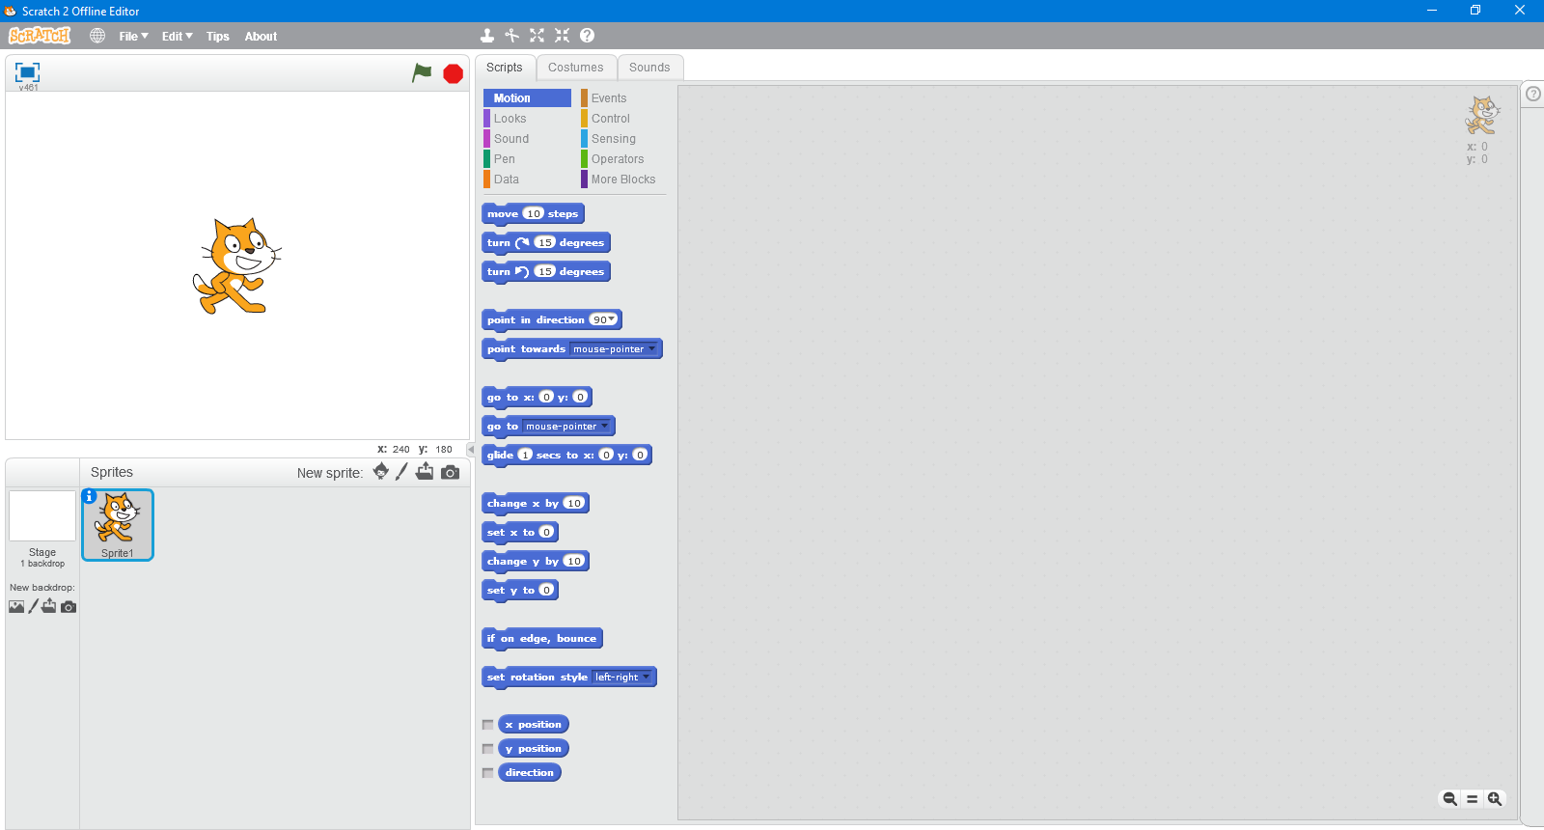
Close this app not as it is ridiculous!

Slide 63
Media player 1.00
Elvis- promised land
Elvis- Burning Love [Aloha From Hawaii]
Long tall sally/whole lotta shaking going on
We have remove the songs to reduce lag in development.
Sorry!

Slide 64
\\websites\windos\news
Windos news official
Back to website
News for Windos 3 v1.00:
Hello. Windos is now an official OS.
Updates will not be that often as I am now focusing on one last OS.
Then I will focus ion them all equally.
Enjoy Windos 3.
Szymon.

Slide 65

\\websites\windos\feedback
Back to main
Advert:
Get Windos 3 here!
Press here to request a copy
Press the button below to send feedback directly to the developer of Windos!
Advert:
Cannot load this advert
retry

Slide 66
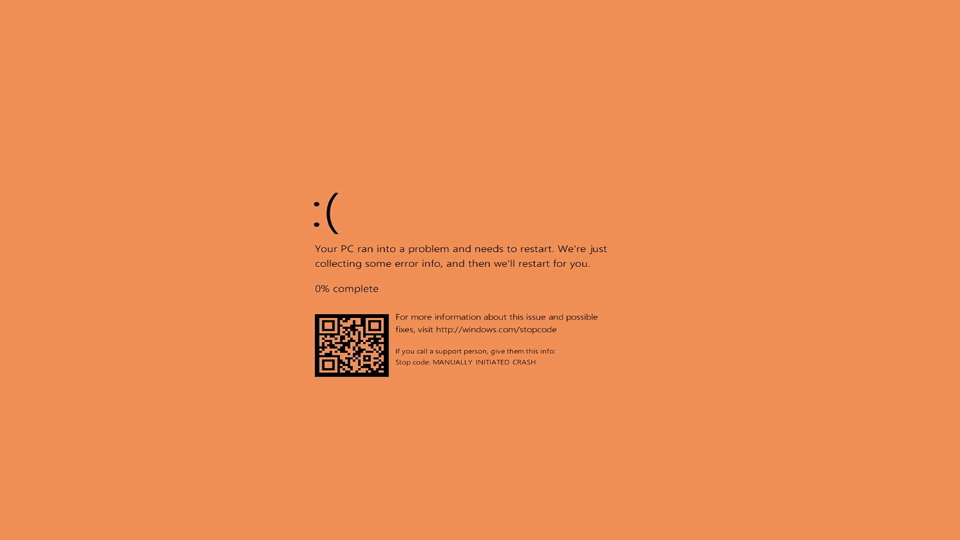

Slide 67
received message
Fr: dev@windos3.org
Sj: Windos 3 v1.00
Hello there Windos user!
You are lucky enough to have a copy of Windos 3 version 1.00!
Thanks for downloading t!
I have worked hard on it and I hope it makes you see PowerPoint in a whole new light.
As a celebration of Windos reaching v1.00, I have removed the mouse pointer from the OS.
Please do look at the whole thing and feel free to mod it as long as my name and these emails are removed.
Signed,
Szymon Mochort
PS my Gmail will send you a message as well.

Slide 68
received message
Fr: bill.gates@Microsoft.com
Sj: what is this horrible windows knock-off?
Hello,
I am the founder of Microsoft.
I created Windows back in 1985 and I have seen a lot of knock-offs of it, but this one is by far the worst.
Where is the code?
I need to see the source code!
Wait, it is just a PowerPoint presentation! How stupid!
Bet the dev used hyperlinks to make it interactive.
Ha ,ha, ha.
Anyways, goodbye from me!
Bill Gates
PS you should see this YouTube video

Slide 69
received message
Fr: szymonmochort11@gmail.com
Sj: support ticket #1
Windos 3 support ticket
Tap on the below button to send an email to me for feedback and support!
I also accept suggestions for features!
Press to send an email

Slide 70
sent message
To: bill.gates@Microsoft.com
Sj: signature request
Can I have a copy of your signature please?
I need it in PPTX format
Signed,
Anonymous Windos 3 user.
PS I also would love a copy of Windows me.

Slide 71

sent message
To: szymonmochort11@gmail.com
Sj: rating of Windos
My rating for Windos:
Signed,
The Windos 3 community.

Slide 72

\\websites\mime102
#evil face

Slide 73

\\websites\
In the name of his murdered parents, Bruce Wayne wages eternal war on the criminals of Gotham City. He is vengeance. He is the night. He is Batman.
One of the most iconic fictional characters in the world, Batman has dedicated his life to an endless crusade, a war on all criminals in the name of his murdered parents, who were taken from him when he was just a child. Since that tragic night, he has trained his body and mind to near physical perfection to be a self-made Super Hero. He's developed an arsenal of technology that would put most armies to shame. And he's assembled teams of his fellow DC Super Heroes, like the Justice League, the Outsiders and Batman, Incorporated.
A playboy billionaire by day, Bruce Wayne’s double life affords him the comfort of a life without financial worry, a loyal butler-turned-guardian and the perfect base of operations in the ancient network of caves beneath his family’s sprawling estate. By night, however, he sheds all pretence, dons his iconic scalloped cape and pointed cowl and takes to the shadowy streets, skies and rooftops of Gotham City.

